Slide 1
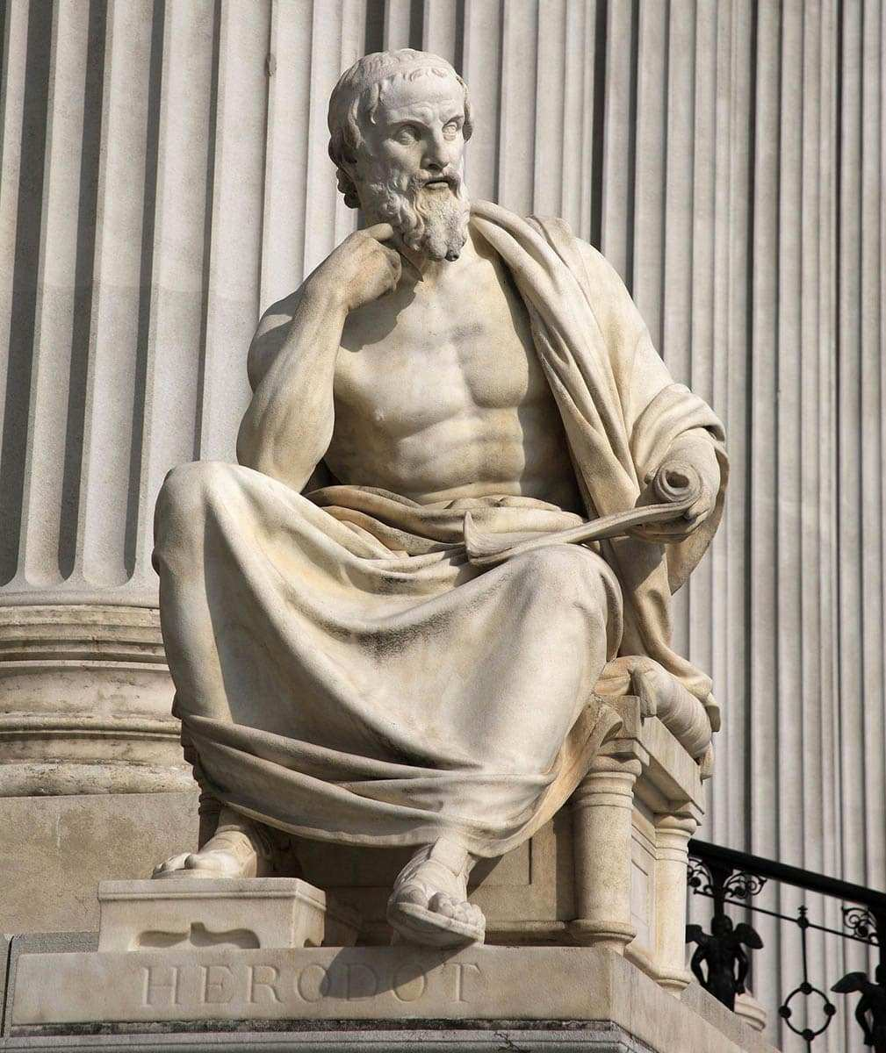
Focus: How did the Greek Golden Age contain both great conflict and great cultural achievement (500 BCE-300 BCE)?
Do now: Who was Herodotus?
https://www.youtube.com/watch?v=A542ixwyBhc
TED ED Video
Reminders:
Complete your SAQ questions in your notebook. Due-Friday 15th 8:00 AM

Slide 2
Herodotus SBMC
When describing the Scythians, a group that was considered barbaric by most Greeks, the historian Herodotus was posed with a challenge; should he neutrally describe their customs or should be strongly condemn them? Herodotus went on to describe them as such;
“As regards war, the Scythian custom is for every man to drink the blood of the first man he kills. The Scythian soldier strips the skin off the head by making a circular cut round the ears and shaking out the skull; he then scrapes the flesh off the skin with the rib of an ox, and when it is clean works it in his fingers until it is supple; and fit to be used as a sort of handkerchief.”
Herodotus The Histories ~425 BCE
1. The writings of Herodotus laid the foundation for what major development in later civilizations?
A. The severe condemnation of non-Greek barbaric peoples.
B. Attempts at the unbiased and objective recording of historical events.
C. The use of propaganda to influence elections in Athens.
D. The construction of universities used to educate Greek citizens.

Slide 3
2. Herodotus’ writing best supports which following historic development?
A. A civilization attempting to understand the cultural differences between them and foreign peoples.
B. The decline of organized civilization due to the onslaught of barbaric peoples.
C. The influence of theocratic governments on local customs.
D. The use of religion to promote political legitimacy.
3. The above passage demonstrates what about Classical Civilizations?
A. Classical Civilizations encouraged the growth of trade routes and cultural diffusion.
B. Monotheistic religions persecuted people who were perceived as barbarians such as the Scythians.
C. Education and diplomacy allowed for the growth of a massive Greek Empire under Alexander the Great.
D. Political power was often achieved through violent conquests of neighboring regions.

Slide 4
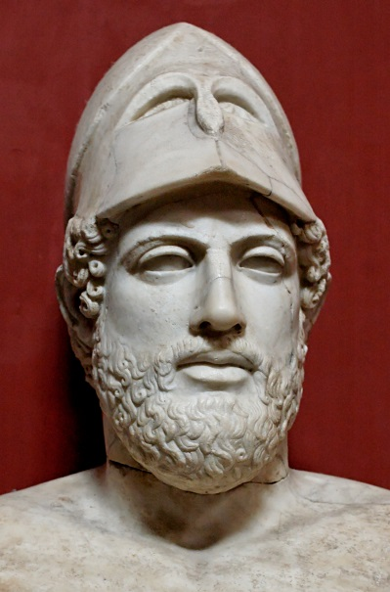
The Age of Pericles- An Experiment in Democracy
Context: Waves of invasions from 499 B.C.E – 449 B.C.E by Persian Emperor’s Darius I and his son Xerxes resulted in shocking Greek victories in both the battles of Marathon (490 BCE) and Salamis (480 BCE).
The Athenians, under Pericles (449 to 431 B.C.E):
1. Strengthen Athenian Democracy and Civic Values
Citizens – born in Athens, must be 18 year’s old/male to vote
B) Leaders chosen by election and lottery.
D) Set up a system of trials where “criminals” were allowed to appear in court to defend themselves.
C) Paid jury system
2.Strengthen the existing Delian League
A) The Delian league was originally a defensive alliance of Greek City-States against the Persian empire. However, Pericles saw it as an opportunity to position Athens as the head city-state of the Greek peninsula.

Slide 5
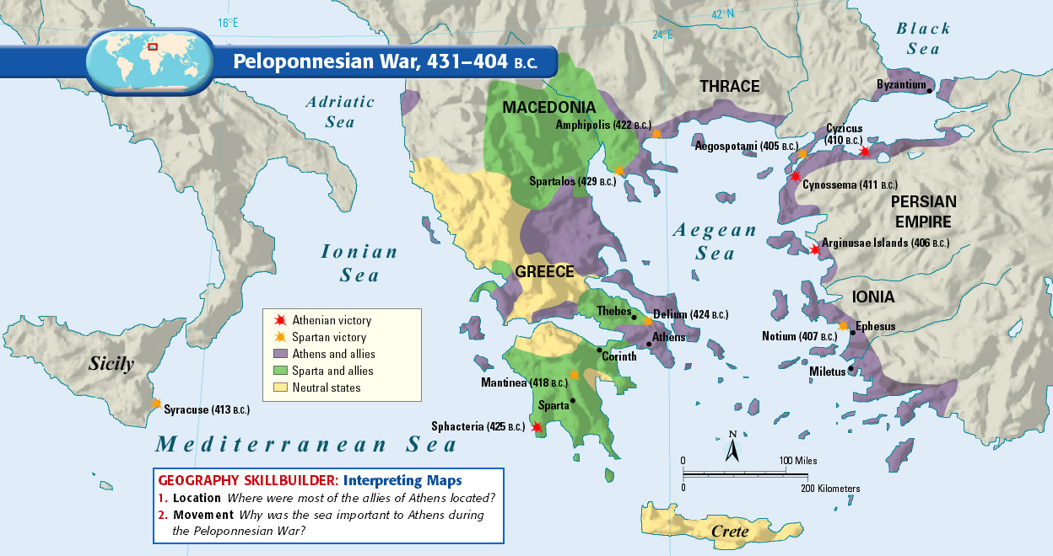
The Peloponnesian War: (431 BCE – 404 BCE)
A) After the defeat of the Persians, Greece became divided into two separate areas.
B) Sparta and its allies feared the growing power of the Athenian city state alliance and went to war.
Results:
The Peloponnesian Wars weakened Greece and destroyed any possibility of cooperation .
Due to the pre-occupation with civil war, they failed to notice the growing power of Macedonia to the North.

Slide 6


SAQ Independent Practice
The Classical Period or Golden Age of Greece, from around 500 to 300 BCE, has given us the great monuments, art, philosophy, architecture and literature which are the building blocks of other future civilizations.
Read the following slides and answer each question with 2-3 sentence responses in your notebook.

Slide 7
Focus: What were the various achievements of the Greek Golden Age?
Document 1: This excerpt is from Pericles’ Funeral Oration, given to Athenians in about 430 B.C.E
“Our plan of government favors the many instead of the few: that is why it is called a
Democracy…
As for social standing, advancement is open to everyone, according to ability. While every citizen has equal opportunity to serve the public, we reward our most distinguished citizens by asking them to make our political decisions. Nor do we discriminate against the poor. A man may serve his country no matter how low his position on the social scale.
”
Q: What type of government was Pericles describing? What were his expectations for citizens in this type of government?
Answer:

Slide 8
AIM: What were the various achievements of the Greek Golden Age?
Document 2: This is an excerpt from the play Antigone written by Sophocles, in about 441 B.C. In this play, Antigone defies the king’s order and buries her brother, who was killed leading a rebellion.
Creon: And still you dared to overstep these laws?
Antigone: For me, it was not Zeus who made that order. Nor do I think your orders were so strong that you, a mortal man, could overrun the gods’ unwritten and unfailing laws…I know I must die…but if I left my brother dead and unburied, I’d have cause to grieve as now I grieve not.
Q: According to the play, where does ultimate authority lie in Greek society?
Answer:

Slide 9
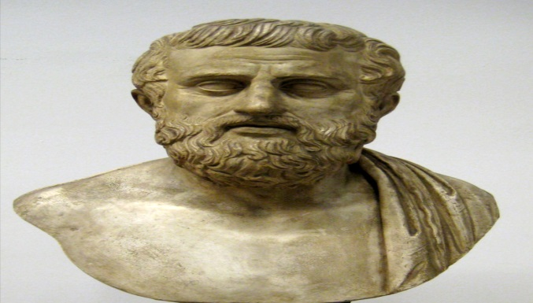
Sophocles- The author of Antigone, a tragedy, written in or before 441 BCE.
TRAGEDY- A drama or literary work in which the main character is brought to ruin or suffers extreme sorrow, especially as a consequence of a tragic flaw, moral weakness, or inability to cope with unfavorable circumstances.
Antigone, compared to her very beautiful and docile sister, is portrayed as the rebel of her family who seems withdrawn and refuses to play by the rules. Antigone rebels against the fundamental rules of her society that states that women must be afraid of the men, who are considered dominant.
Supplemental Source: DBQ Document #2

Slide 10
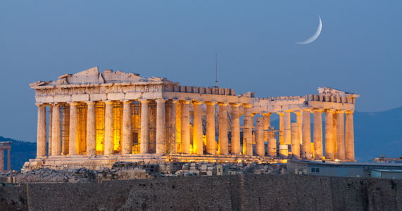
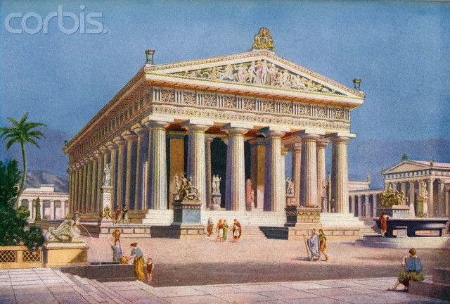
Focus: What were the various achievements of the Greek Golden Age?
Document 3: The Parthenon
Q: How have specific features of this building influenced Western civilization?
Answer:

Slide 11
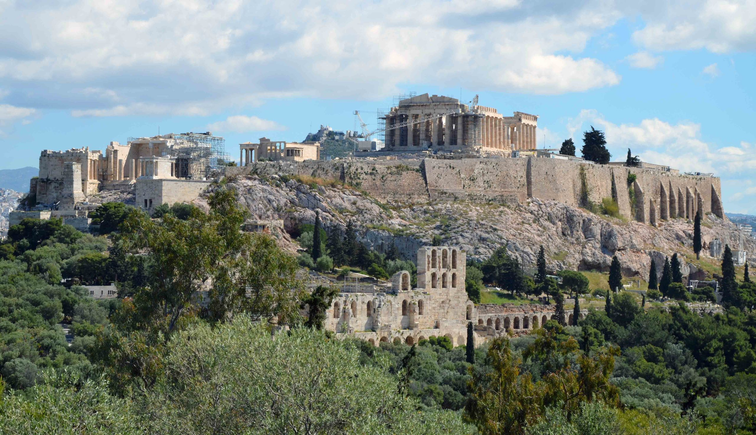
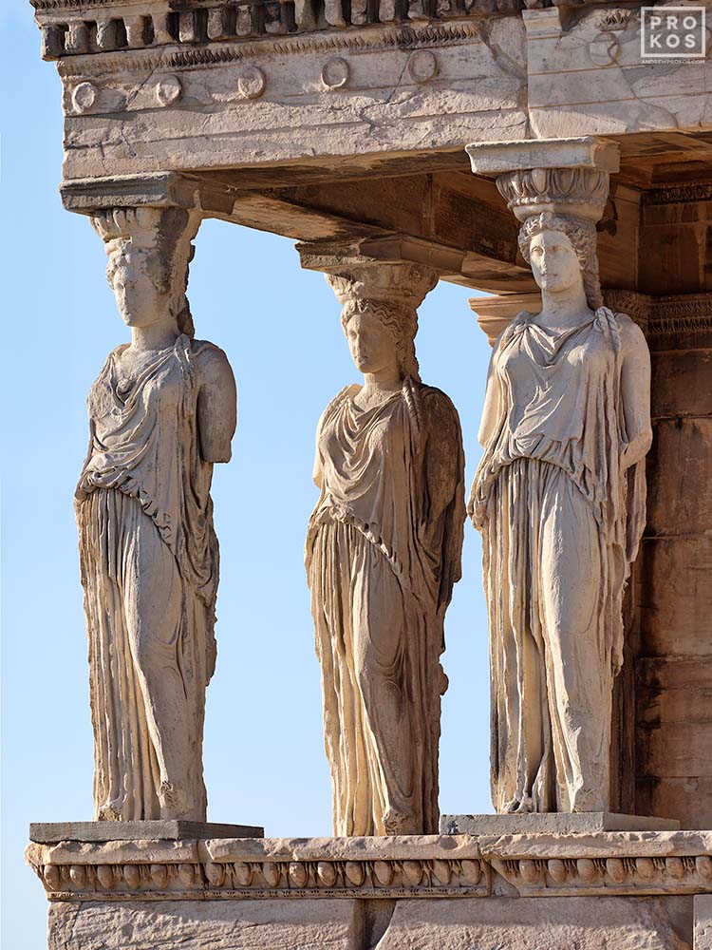
Architecture- Value of Symmetry and Balance
The ruins of the original Acropolis in Athens.
The caryatid porch of the Erechtheion in Athens, Greece.
Supplemental Source: DBQ Document #3

Slide 12
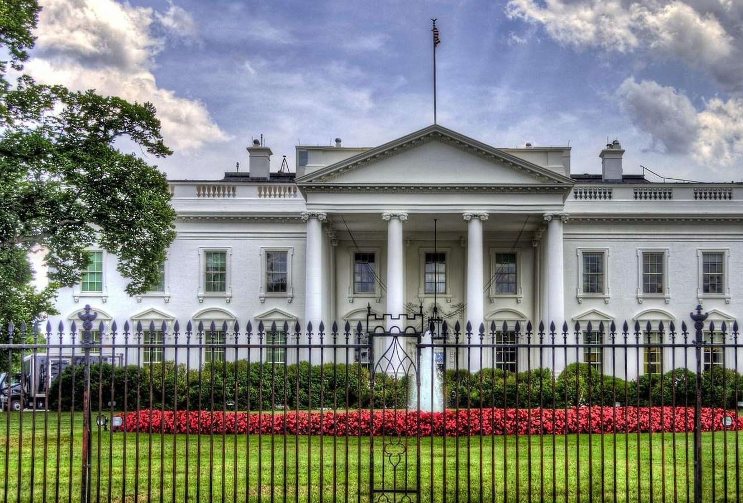
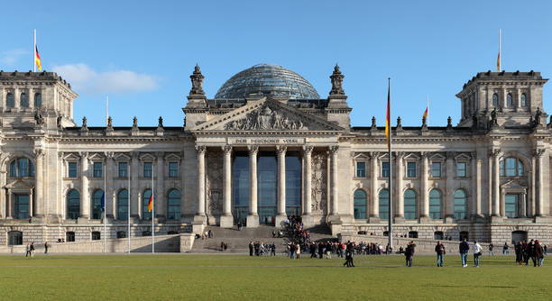
The White House –United States Residence/Office of the President (Executive Branch)
The German Parliament- Legislative Body

Slide 13
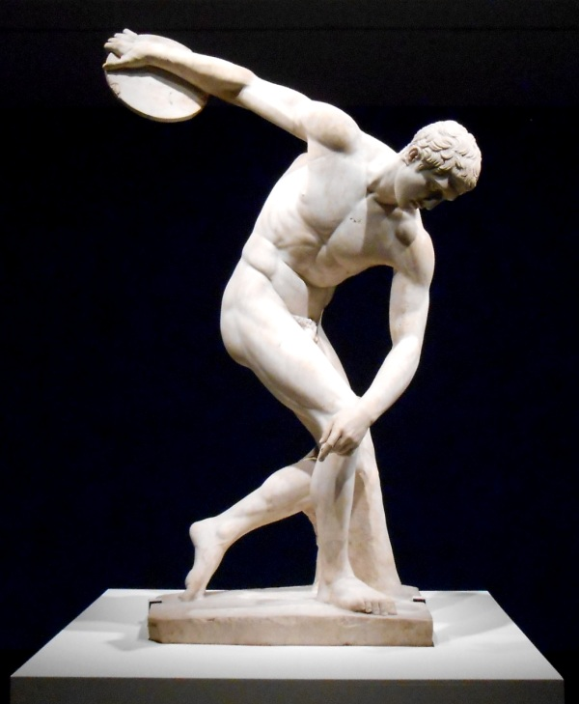
Focus: What were the various achievements of the Greek Golden Age?
Document 4: Myron’s famous marble sculpture of The Discus Thrower (Diskobolus) represents
an Olympic field event. (460-450 BCE)
Q: What does this statue reveal about Greek values?
Answer:

Slide 14
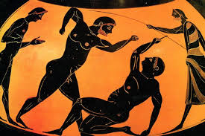
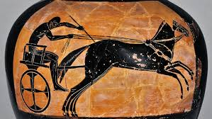
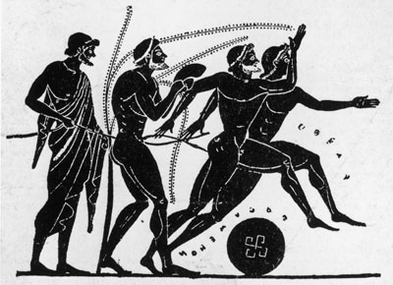
Olympic Event
Focus: What were the various achievements of the Greek Golden Age?
The Ancient Olympic Games were an athletic and religious celebration held in the Greek town of Olympia from (historically) as early as 776 BC to 393 AD.
Supplemental Source: DBQ Document #4

Slide 15
Focus: What were the various achievements of the Greek Golden Age?
Document 5: This excerpt is from the Elements, written by Euclid in about 300 B.C.E
Proposition15, THEOREM: If two straight lines cut one another the vertical, or opposite, angles shall be equal.
Q: Who was Euclid, and what has been the impact of his work? Think- what modern day professions rely on geometry?
Answer:

Slide 16
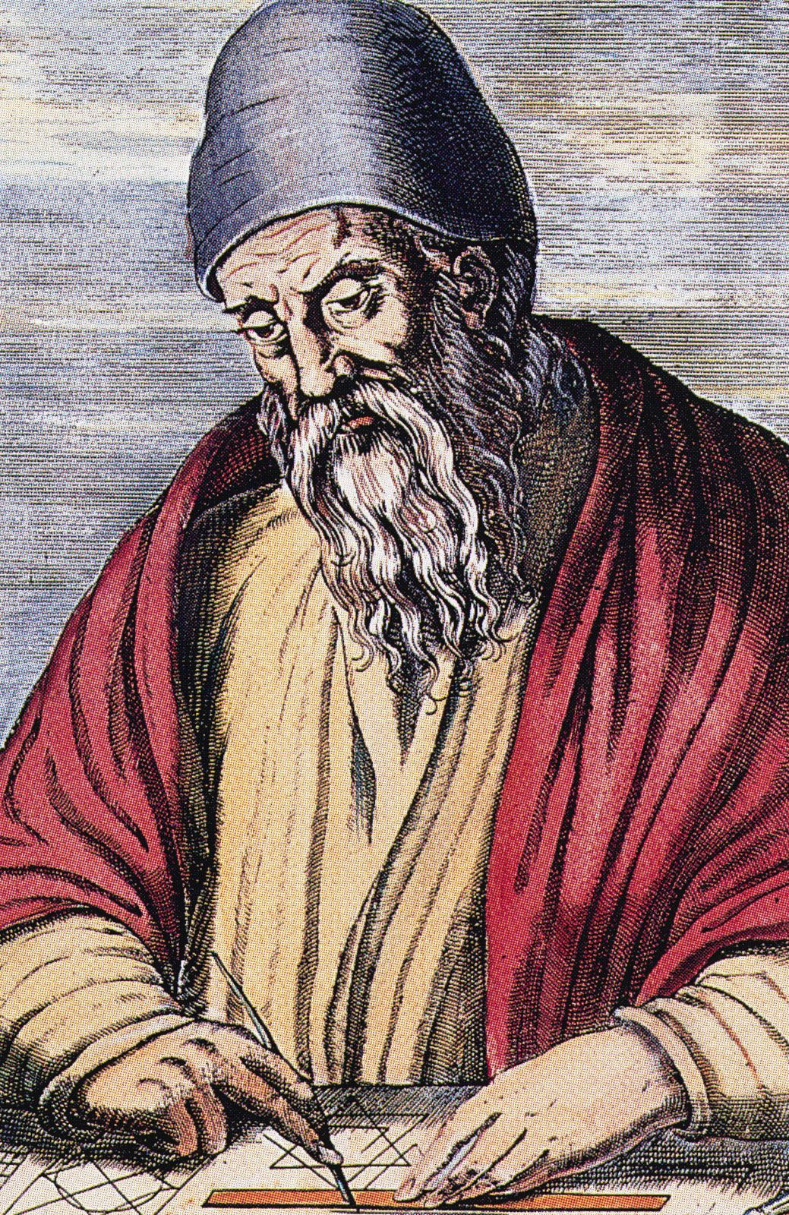
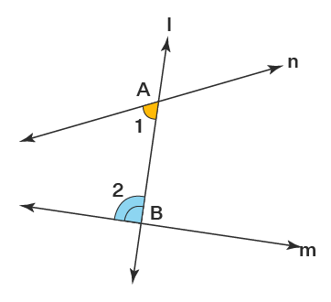
Mathematic Achievements
Euclid- an Ancient Greek mathematician and philosopher. In one of his most influential works, Elements, Euclid deduced the principles of what is now called Euclidean geometry.
Supplemental Source: DBQ Document #5

Slide 17
Focus: What were the various achievements of the Greek Golden Age?
Document 6: The following is an excerpt from the Hippocratic Oath. Hippocrates, creator of this oath and medical physician, lived from about 460 to about 377 B.C.
I will follow that [treatment] which, according to my ability and judgment, I will consider for the benefit of my patients, and abstain from whatever is [harmful]. I will give no deadly medicine to anyone if asked, nor suggest any such [advice]…
Q: What was Hippocrates promising to do and how does it connect to the Greek idea of civic values?
Answer:

